Slide 1
Security Assertion Mark-up Language
SAML 2.0 – ASP.NET
This application delegates the user authentication & authorization
to Identity Providers (SingPass/CorpPass)

Slide 2
Modules included
Acting as the SAML service provider (SP)
Service provider initiated Single Sign On (SSO)
Setting and retrieving SAML attributes
Single Logout (SLO)

Slide 3



Acting as SAML Service Provider
Three main Components
Users
Service Provider
Identity Provider

Slide 4
Acting as SAML Service Provider
SAML in a nutshell – Service-provider-initiated login
❶
User tries to log on SP side.
SP generates SAML Request
Redirects to IDP for Authentication
Authenticate Certificate & SAML Assertion
Sends back the SAML Response
Redirects back to SP with SAML Response
Authenticate certificate or metadata, create
local session for user.
Enables login.
❷
❻
SERVICE PROVIDER
❽
❼
USERS/Browsers
❸
❺
IDENTITY PROVIDER
❹

Slide 5
Acting as SAML Service Provider
SAML in a nutshell – Identity-provider-initiated login
User tries to log on IDP side
IDP generates SAML Assertion
Redirects to SP with SAML Response
Identify users, Authenticate Certificate
Enables login.
❶
IDENTITY PROVIDER
❸
❷
USERS/Browsers
❹
❺
SERVICE PROVIDER

Slide 6
Acting as SAML Service Provider
Certificates in SP and IDP
❷
IDP authenticates SAML request/SP’s signature by
SP’s public key
❶
SAML Request
Digitally signed by SP’s private key
Service Provider
Identity Provider
SP’s Private Key
IDP Metadata
IDP’s Private Key
SP Metadata
IDP’s Public Key
SP’s Public Key
❹
SP authenticates SAML response/IDP’s signature by
IDP’s public key
❸
SAML Response
Digitally signed by IDP’s private key

Slide 7

Acting as SAML Service Provider
Certificates in SP
There are several options listed for creating keys, but many organizations create their own self-signed certificate/private key. We can do this by PowerShell as documented in the Certificate Guide.
Options to create certificate/private key
• Self-signed
• CA-issued
• Shared with HTTP
Service Provider
SP Metadata
SP’s Private Key
SP’s Public Key

Slide 8

Acting as SAML Service Provider
Certificates Storage
SAML configuration supports certificates stored in:
•Certificate file
•Windows certificate store
•Certificate string
•Application configuration
•Azure key vault

Slide 9
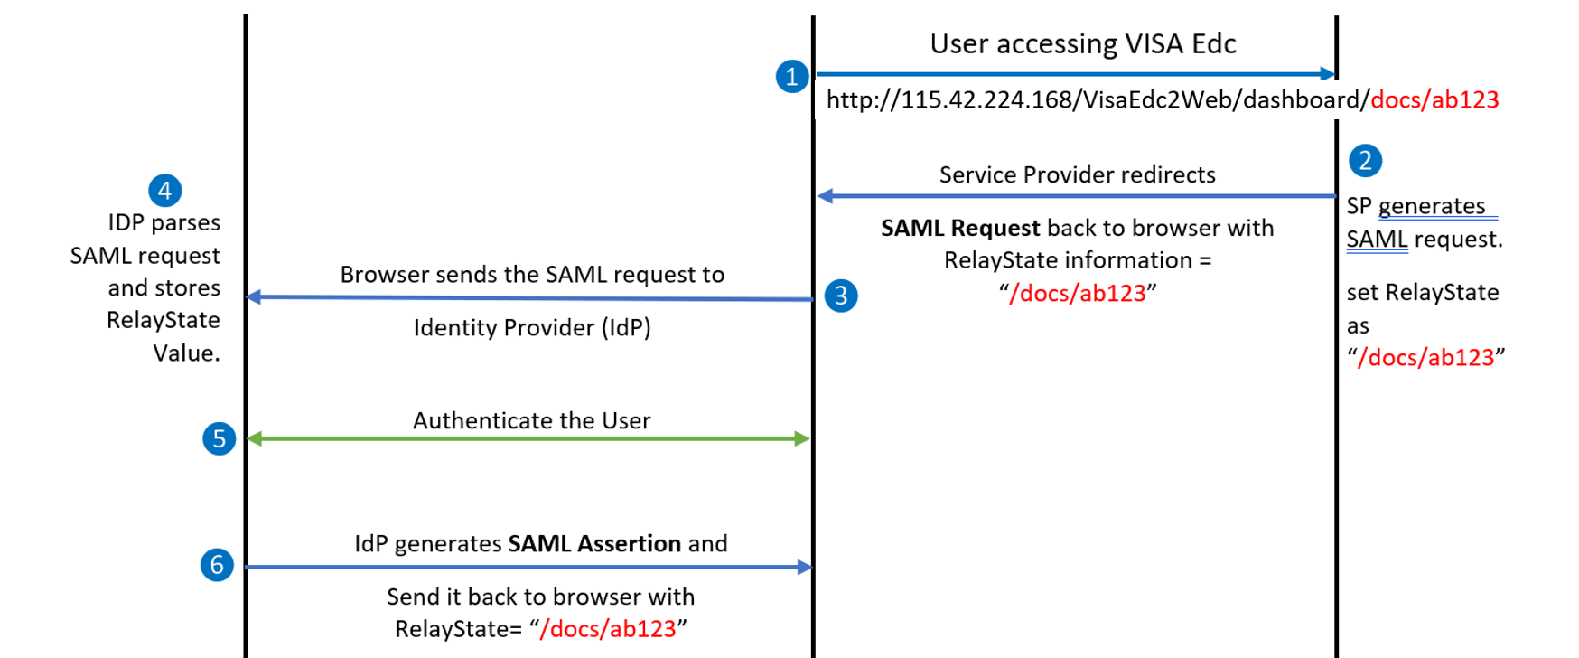
Acting as SAML Service Provider
SAML Workflow

Slide 10
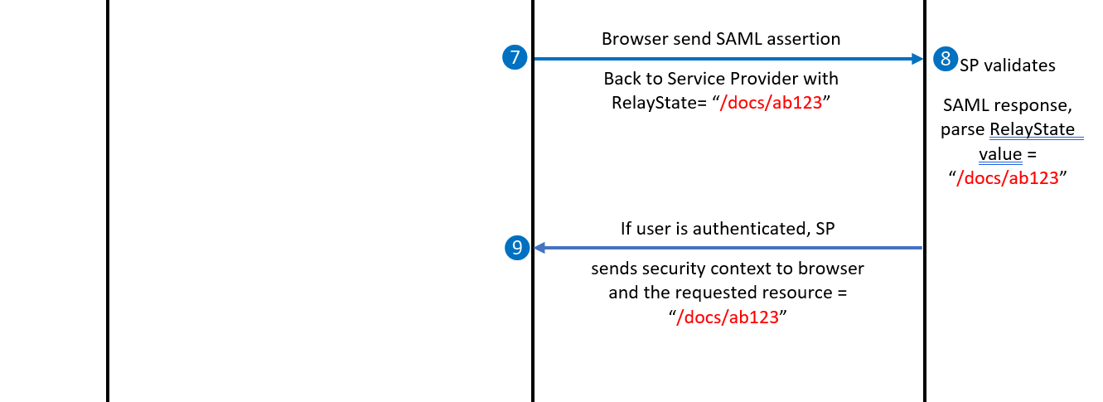
Acting as SAML Service Provider
SAML Workflow contd.

Slide 11
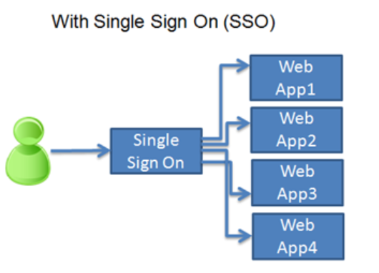
SP Initiating Single Sign On (SSO)
Why SSO ?

Slide 12
Setting and retrieving SAML attributes
SAML Response (IdP -> SP)
A SAML Response is sent by the Identity Provider to the Service Provider and if the user succeeded in the authentication process, it contains the Assertion with the NameID (email address ) / attributes of the user.
There are 8 examples:
An unsigned SAML Response with an unsigned Assertion
An unsigned SAML Response with a signed Assertion
A signed SAML Response with an unsigned Assertion
A signed SAML Response with a signed Assertion
An unsigned SAML Response with an encrypted Assertion
An unsigned SAML Response with an encrypted signed Assertion
A signed SAML Response with an encrypted Assertion
A signed SAML Response with an encrypted signed Assertion

Slide 13
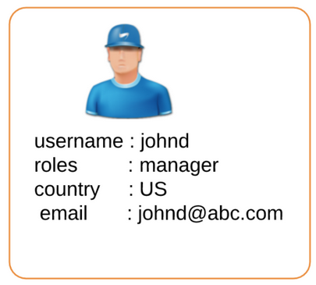
SAML Assertion
An Assertion is a set of security statements about a subject created by a Asserting Party (AP), in most common use cases it is about an individual.

Slide 14
SAML Assertion
Authentication statements
Authentication assertions prove identification of the user and provide the time the user logged in and what method of authentication they used (I.e., Kerberos, 2-factor, etc.)
Attribute statements
Used to describe attributes above the authenticated user. SAML attributes are specific pieces of information about the user.
Authorization decision statements
Used to express something that the user entitled to perform, such as access a page etc.
Three types of assertions.

Slide 15
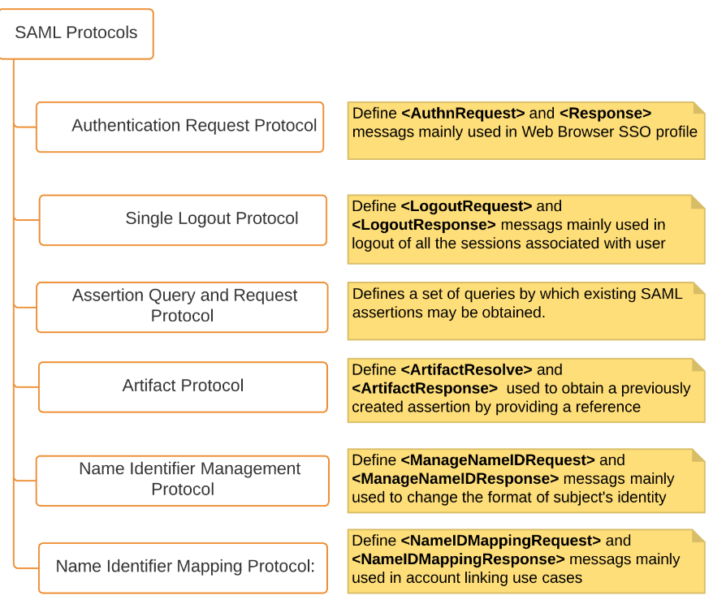
SAML Protocols
These are the message formats that can be generated and can be used to exchange SAML assertions

Slide 16
SAML Bindings
Encoding SAML message within HTTP POST request body
OR
Encoding SAML message within the body of SOAP message
HTTP Redirect Binding
HTTP Post Binding
Reverse SOAP (PAOS) Binding
HTTP Artifact Binding
SAML SOAP Binding
SAML URI Binding
SAML Binding specify exact semantics to transmit SAML messages via other protocols.
What’s special in HTTP Artifact Binding?
it uses a special token to transport sensitive information between Identity Provider and Service Provider.

Slide 17
Setting and retrieving SAML attributes
SAML Redirect Bindings
SERVICE
PROVIDER
IDENTITY
PROVIDER
❻
Supply
resources
Assertion Consumer Service
Single Sign On services
❶
Try to Access
Resources
❺
SAML assertion
<Response>
❹
User
login
❷
Redirect with
<AuthnRequest>
❺
POST SAML
assertion
<Response>
❷ GET
<AuthnRequest>
❸
Ask for
Credentials
USERS/Browsers

Slide 18
Setting and retrieving SAML attributes
SAML Artifact Bindings
❻ <Artifact Resolve> (SOAP)
IDENTITY
PROVIDER
SERVICE
PROVIDER
Artifact
Resolution
Service
❼
<Artifact Response> (SOAP)
❽
Supply
resources
Assertion Consumer Service
SSO
❶
Try to Access
Resources
❺
Redirect with
SAMLArt
❹
User
login
❷
Redirect with
<AuthnRequest>
❺
GET
SAMLArt
❷ GET
<AuthnRequest>
❸
Ask for
Credentials
USERS/Browsers

Slide 19
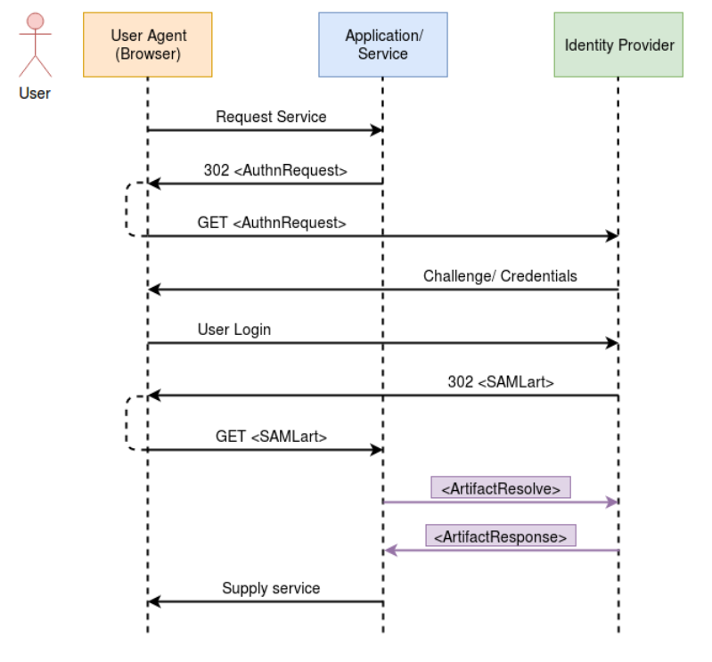
SAML Bindings

Slide 20
Single Logout (SLO)
HTTP redirect- SP initiated SLO
❶
User clicks logout button.
SP generates SAML LogoutRequest
Redirects to IDP
Destroy all sessions
Sends back the SAML LogoutResponse
Redirects back to SP with SAML Response
User is logout of SP and IDP
❷
❻
SERVICE PROVIDER
❼
USERS/Browsers
❸
❺
IDENTITY PROVIDER
❹

Slide 21
Library for SAML (ComponentSpace)
Libraries to develop SAML-enabled services
Libraries and Toolkits
ComponentSpace
Purpose and Language bindings
SAML libraries for ASP.NET and ASP.NET Core applications
Licence
Commercial
Latest Versions
ComponentSpace SAML v2.0 for ASP.NET Releases
v3.4.0

Slide 22



Free IDPs for testing
xecurify.com
https://wso2.com
https://samlidp.io

Slide 23

System Requirements
My local Machine specs:
Processor : i7-6500U CPU, 2.50GHZ
RAM: 16GB
1TB HDD
Cannot estimate the load of network traffic…

Slide 24
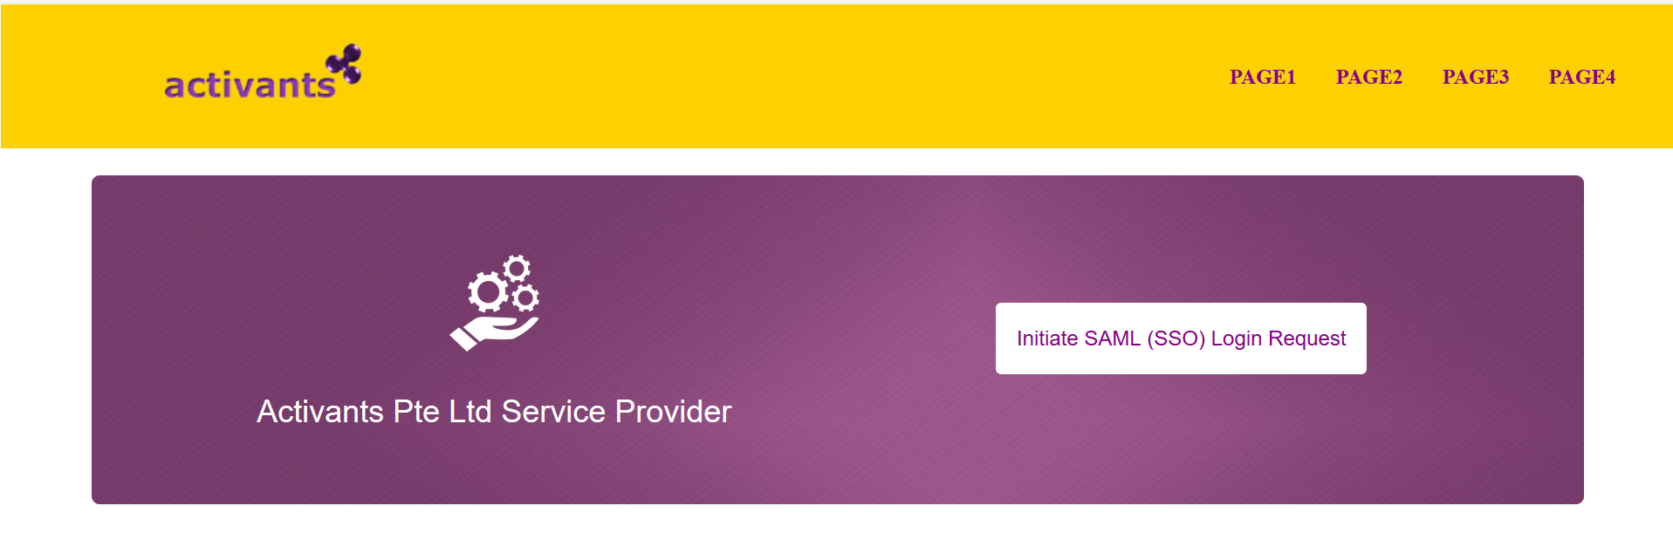
Prototype

Slide 25
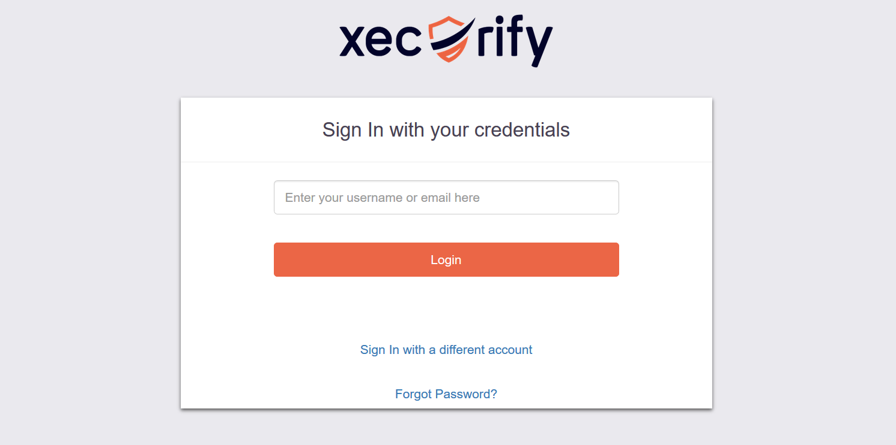
Prototype

Slide 26
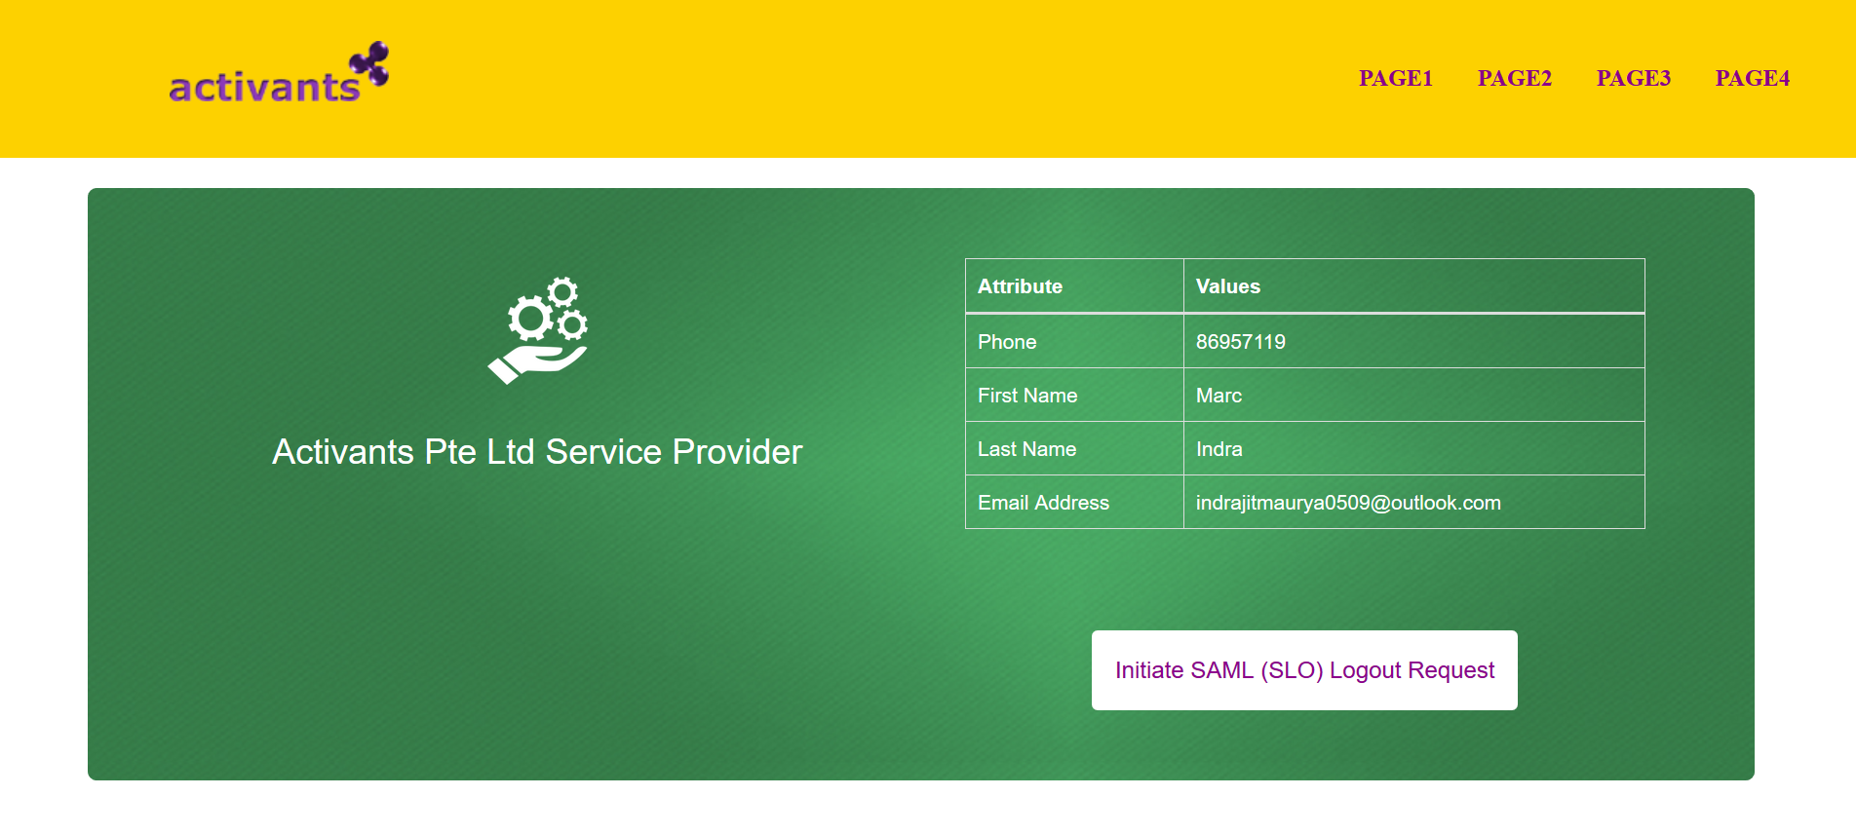
Prototype

Slide 27
Frameworks
.NET Framework: 4.8
Entity framework : 6.3.0
ComponentSpace.SAML2: 2.6.0

Slide 28
Tasks
My Tasks | Completed | Reasons
SAML service provider (SP) | ✓
Initiate Single Sign On |  | Create two to more apps to check SSO
Retrieving attributes | ✓
Initiate Single Logout | ✓
Convert from Web forms To MVC
Create a demo application and test SP
Validations and Security check.

Slide 29


